Slide 1
PROJECTION OF
PLANES

Slide 2
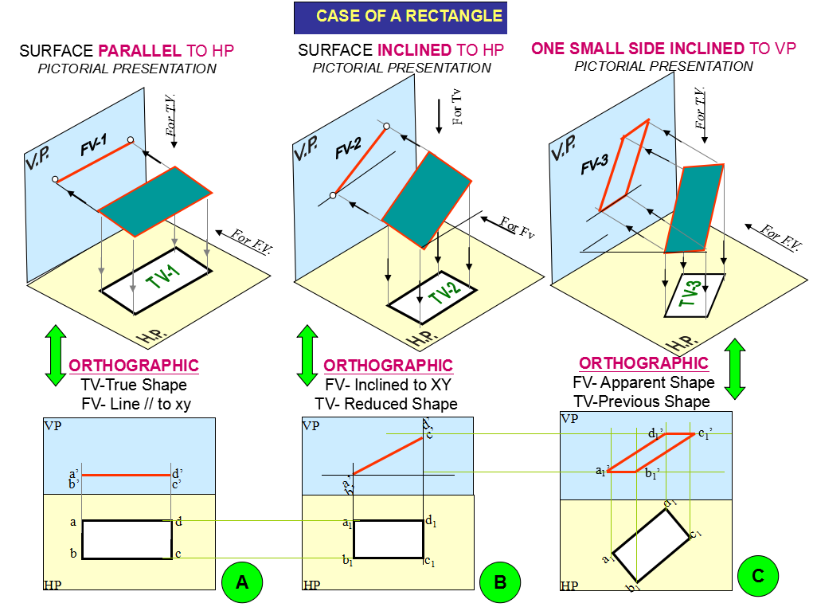

Slide 3
Class A(1): Plane parallel to P.P. and hence perpendicular to both H.P. & V.P.
Y
V.P.
a”
V.P.
P.P.
a’,b’
P.P.
b’,a’
a”
b”
A
b”
d”
Y
c’,d’
D
B
c”
c’,d’
c”
d”
C
X
Y
a,d
a,d
H.P.
X
b,c
b,c
X
H.P.
Z

Slide 4
Class A(2): Plane parallel to V.P. and hence perpendicular to both H.P. & P.P.
Y
A, a’
B, b’
V.P.
b’
a’
D, d’
F.V.
C, c’
B
c’
Y
X
Y
d’
A
C
b, c
D
H.P.
X
a, d
a, d
b, c
T.V.
X

Slide 5
Class A(3): Plane parallel to H.P. and hence perpendicular to both V.P. & P.P.
Y
V.P.
c’,d’
D
a’,b’
c’,d’
b’,a’
C
F.V.
A
Y
X
Y
B
d
a
d
c
X
a
H.P.
b
b
c
X
T.V.

Slide 6
Class B(1): Plane perpendicular to V.P. and inclined to H.P. by  & also inclined to P.P.
Y
V.P.
b’, c’
b’, c’
.

B
a’, d’
F.V.
C

Y
X
Y
a’, d’
A
b
a
b

D
H.P.
X
a
c
d
d
c
= 
T.V.
X

Slide 7
Exercise 01:
A regular hexagonal plate ABCDEF, 30mm side, is resting on H.P. on one of the sides/edges with surface of the plate making 45º with H.P. and perpendicular to V.P. Draw the projections of the plate.

Slide 8
Data Given:
(1) Hexa. Plate Size = 30mm
V.P.
(2)  = 45°
d’,e’
E
c’,f’
Y
D
F

f
e
a’,b’
d’e’
C
d
A,a
H.P.
c’f’
E,e
F,f
a’b’
c
B,b
A,a
D,d
X
C,c
B,b

Slide 9
Data Given:
(1) Hexa. Plate Size = 30mm
(2)  = 45°
d₁’,e₁’
c₁’,f₁’
c’,f’
d’,e’
a₁’,b₁’
a’,b’

X
f
Y
f₁
a
e
a₁
e₁
30
b
d
b₁
c
d₁
Scale: 1:1
c
c₁

Slide 10
Class B (2): Plane perpendicular to H.P. and inclined to V.P. by Φ & also inclined to P.P.
Y
.
V.P.
a’
b’
b’
a’
d’
c’
☞
F.V.
A
B
c’
Y
X
.
Y
d’
D
C
a, d

a, d

X
b, c
H.P.
T.V.
b, c
 = 
X

Slide 11
Exercise 02:
A square plate PQRS, edge 25mm size, is in space with one of its corners on V.P. Surface of the plate makes 60º with V.P. and it is perpendicular to H.P. Draw its projections.

Slide 12
Data Given:
V.P.
- Square Plate Size=25mm
s’
- Φ=60º
S
r’
,s’
P,p’
S
,r’
R
Y
R
q’
Φ
Q
P
p
p’
q,s
,q’
r
r
Q
H.P.
q,s
p
X
X

Slide 13
Data Given:
(1) Square Plate Size=25mm
s’
S
s₁’
(2) Φ=60º
P
r’
p₁’
p’
r₁’
R
q’
q₁’
Q
X
Y
p
q,s
r
p₁
Φ
q₁,s₁
r₁

Slide 14
Class B (3): Plane perpendicular to P.P. and inclined to H.P. by  & to V.P. by Φ
Y
V.P.
b’
a”,b”
P.P.
a’
B

A
Y


d’
c”,d”
C

H.P.
X
a
D
c
Z
d
X

Slide 15
Exercise 03:
A rectangular plate PQRS 30mm X 60mm size, is in space with shorter edge parallel to H.P. and 20mm above it. Plate PQRS is perpendicular to V.P. and inclined to H.P. by such an angle so that its plan becomes square. Draw the projections.

Slide 16
Data Given:
c₁’d₁’
- Size of rectangle=30mmX60mm
Distance of plane from H.P.=20mm
(plane is parallel to H.P.)
T.L.
- Size of Plan=square of 30mm X 30mm
θ
a’,b’
c’,d’
a₁’,b₁’
20
X
Y
A
D
,a
,d
a₁
d₁
30
b₁
c₁
B
,b
60
C
30
,c

Slide 17
Exercise 04:
A regular pentagonal plate of 30mm sides, has one of its corners on H.P. The plane of the pentagon is inclined at 45º to the H.P. The side of the pentagon, which is opposite to the corner, which is on H.P. is inclined at 30º to the V.P. Draw the projections of the plate.

Slide 18
Data Given
- Size of Pentagonal Plate =30mm
-  = 45°
-  = 30°
c₁’,d₁’
d₂’
c₂’
T.L.
b₁’,e₁’
e₂’
b₂’
a’
b’,e’
c’,d’
a₁’
θ
X
a₂’
Y
e
e₁
Φ
d
d₂
30
d₁
e₂
c₂
a
a₁
c
c₁
a₂
b₂
b
b₁
Scale = 1:1

Slide 19
Exercise 05:
A regular hexagonal plate 40mm side is resting on one of its edges on H.P. The plane makes an angle of 30º to H.P. and its longest diagonal makes an angle of 45 º with V.P. Draw its projections.

Slide 20
Data given :-
(1) Regular hexagonal plate size = 40mm
(2) Θ =30º
(3) = = 45º
Scale = 1:1
d₁’e₁’
e₂’
d₂’
T.L
f₂’
a’b’
a₁’b₁’
c₁’f₁’
a₂’
c₂’
c’f’
d’e’
θ
X
Y
f
f₁
b₂’

f₂
e₂
a
e
a₁
e₁
d₂
40
a₂
b
d
b₁
d₁
c₂
c
c₁
b₂

Slide 21
Exercise 06:
A 30º- 60º set square has its shortest side 40mm long and is in the H.P. The top view of the set square is an isosceles triangle and the hypotenuse of the set square is inclined at an angle of 45º with the V.P. Draw the projections of the set square and find its inclination with the H.P.

Slide 22
Data:-
Answer:-
(1) T.L.(AB)=40mm
(1) θ =
55º
(2) Φ=45º
Locus of c’
c₁’
c₂’
R=T.L.
a’,b’
c’
a₁’,b₁’
θ
b₂’
a₂’
X
Y
a
a₁
a₂
60º
T.L.
P.L.
Φ
40
40
β
30º
T.L.
c₁
P.L.
c
b₁
40
b₂
b
c₂
Scale:-1:1
Locus of c

Slide 23
Laboratory Questions
Question-1
PQRS is a rhombus having diagonal PR = 60 mm and QS = 40 mm and they are perpendicular to each other. The plane of the rhombus is inclined with HP such that its top view appears to be square. The top view of PR makes 30° with VP. Draw its projections and determine inclination of the plane with the HP.

Slide 24
Laboratory Questions
Question-2
A regular hexagon of 40 mm side has a corner in the HP. Its surface is inclined at 45° to the HP and the top view of that diagonal containing corner which is in the H.P. makes an angle of 40⁰ with the V.P. Draw its projections.

Slide 25
Laboratory Questions
Question-3
A plate having shape of an isosceles triangle has base 50 mm long and altitude 70 mm. It is so placed that in the front view it is seen as an equilateral triangle of 50 mm sides and one side inclined at 45° to XY. Draw its top view.

Slide 26
Laboratory Questions
Question-4
A semi-circular plate of 80 mm diameter has its straight edge in the VP and inclined at 45° to the HP. The surface of the plate makes an angle of 30° with VP. Draw its projections.

